Slide 1

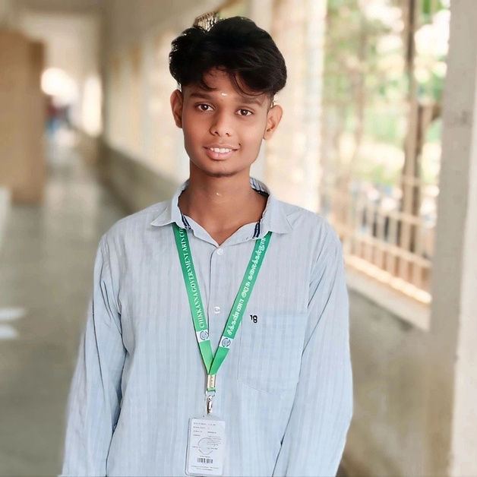
Digital portfolio
By
SATHEESH KUMAR.A
Page | 01

Slide 2
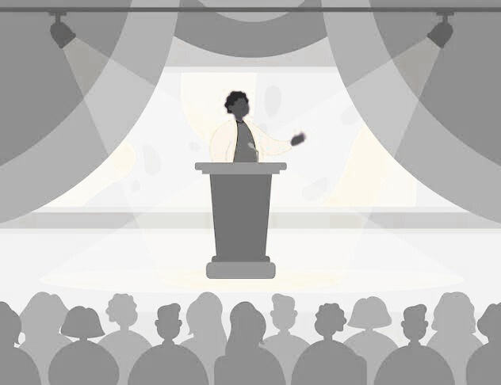
ABOUT ME
NAME : SATHEESH KUMAR
NMID : asbru062422k1902
REG NO : 2422k1902
• DEGREE: UG
• DEPARTMENT: BACHELOR OF COMPUTER SCIENCE
• COLLEGE NAME: CHIKKANNA GOVERNMENT ARTS COLLEGE
• PLACE : TIRUPPUR.
Page | 02

Slide 4


PROBLAM STATEMENT
Traditional paper resumes lackaccessibility, design, and interactivity Need for a digital portfolio to showcase. Personal info & bio-dataEducation & skillsExtracurricular activities & achievements.
Goal: Develop a responsive portfolio website for sabari priya using
HTML, CSS, JavaScript with a user-friendly and visually appealing design.
Page | 04

Slide 5

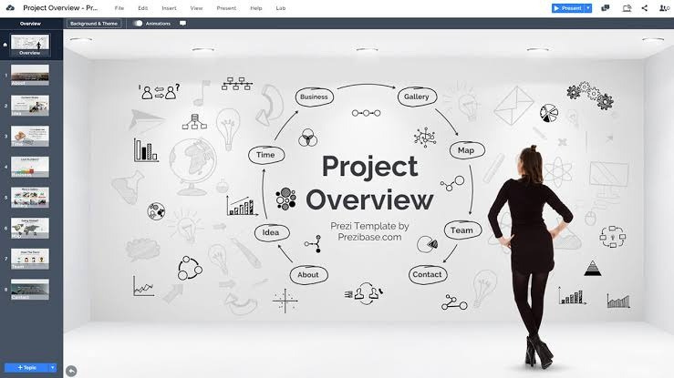
PROJECT OVERVIEW
TECHNOLOGIC USED :
PURPOSE :
HTML5 – Structure CSS3 – Styling (dark theme + purple and hot pink ) JavaScript – Interactivity & footer
Online resume for Satheesh kumar Showcases personal details, education , skills, activities & bio-data
KEY FEATURES :
OUTCOMES :
Hero Section (photo, name, tagline) Tabbed Navigation (About, Education, Skills, Activities, Bio Data)
Responsive Design (desktop & mobile)
Dynamic Footer (auto year update)
Professional,user-friendly& interactive portfolio
Overcomes paper resume limitations Easy to update for future use
Page | 05

Slide 6
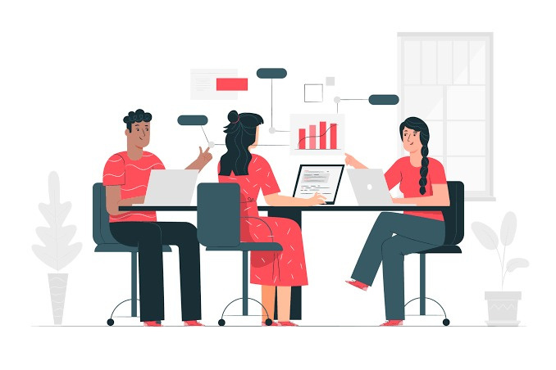

END USER
Recruiters / HiringManagers → View bio-data, skills & qualifications for
internships/jobs
College Faculty / Guides → Evaluate project & use as teaching model Peers & Classmates → Reference & inspiration for own portfolios
Student (Satheesh kumar) → Main user; online resume, easy to update &
share
Page | 06

Slide 7


TOOLS AND TECHNOLOGIES
FRONT END :
HTML5→Structure(About, Education, Skills, Activities, Bio Data)
CSS3 → Styling (white theme, red , responsive layout) JavaScript → Interactivity (tab switching, auto footer year)
VS Code / Notepad++ – Code editing
Browsers – TestingPaint / Canva – Profile image
Hosting
DESIGN TOOLS :
:
HOSTING
Hub Pages / Netlify / Vercel – Deployment
(Optional)Git
Page | 07

Slide 8


PORTFOLIO DESIGN AND LAYOUT
SECTION :
OVERALL DESIGN :
About: Intro+skills (C,C++, Java, Python) Education:Academic details Skills: Programming, soft & language skills Activities: playing, Drawing ,work
Dark theme withpurpleandhot pink highlights Clean fonts, gradient background, soft shadows & hover effects
Bio Data: Grid layout (DOB, Contact,
Email, Parents, Objective)
LAYOUT STRUCTURE :
FOOTER
→
Auto-updating year
Header (Hero) → Profile photo, name, tagline, tab menu
Responsiveness
CSS Grid & Flexbox
Tabbed Navigation → About, Education, Skills, Activities, BioData Cards → Each section in card format with titles & spacing
Desktop → 2-column layout Mobile → Stacks to 1-column
Page | 08

Slide 9
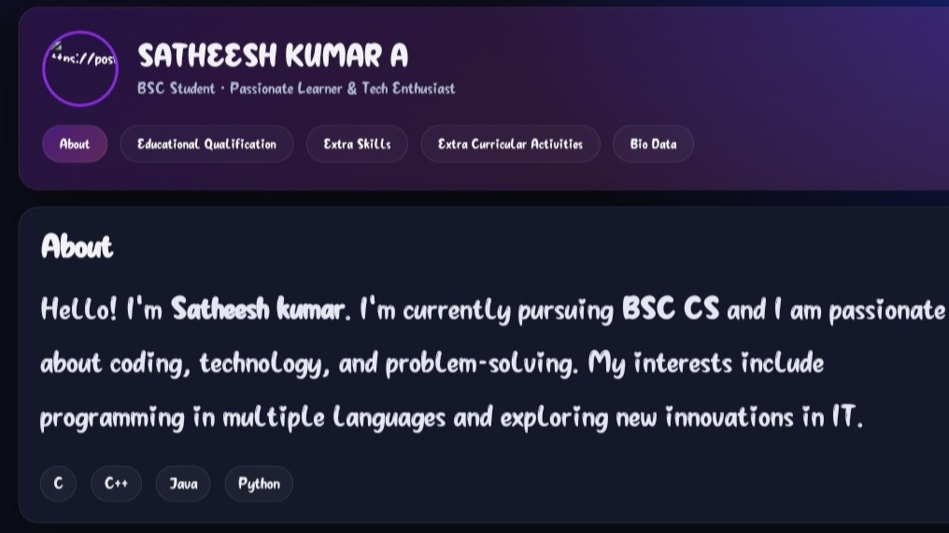
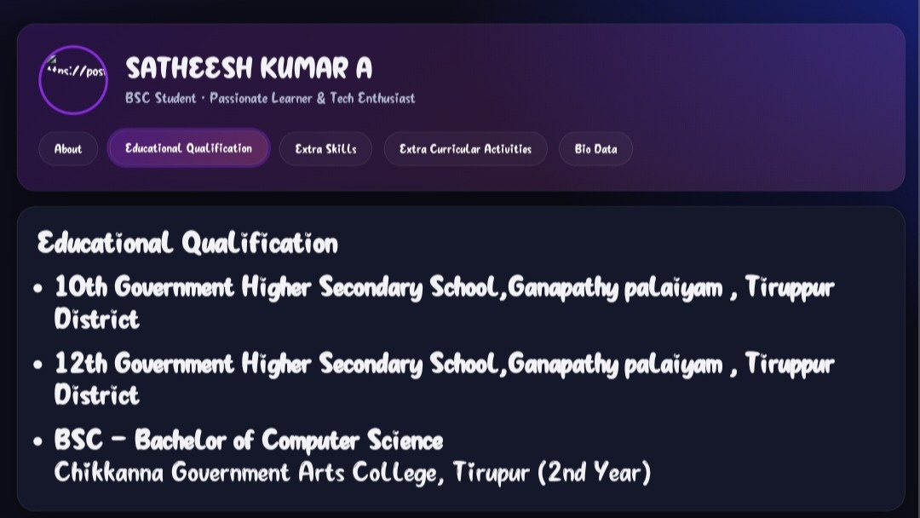
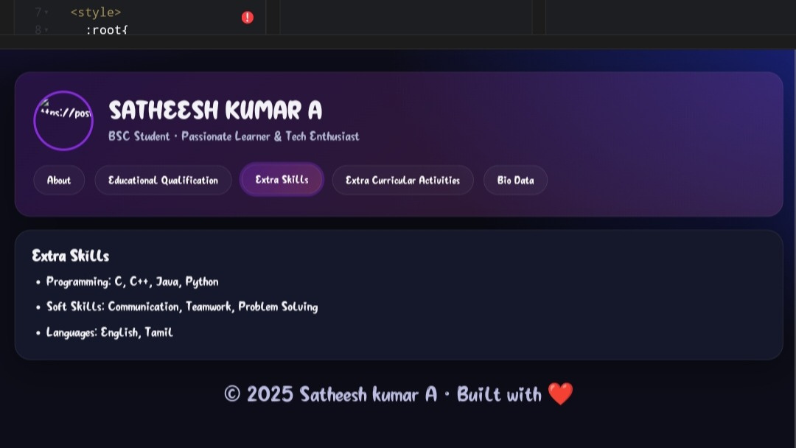
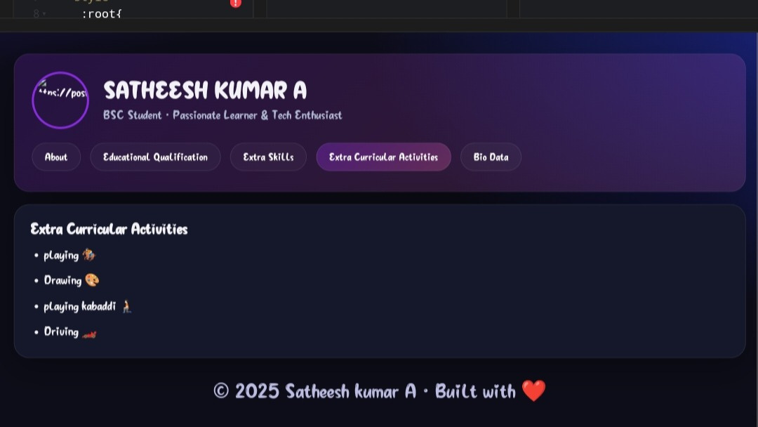

Slide 10
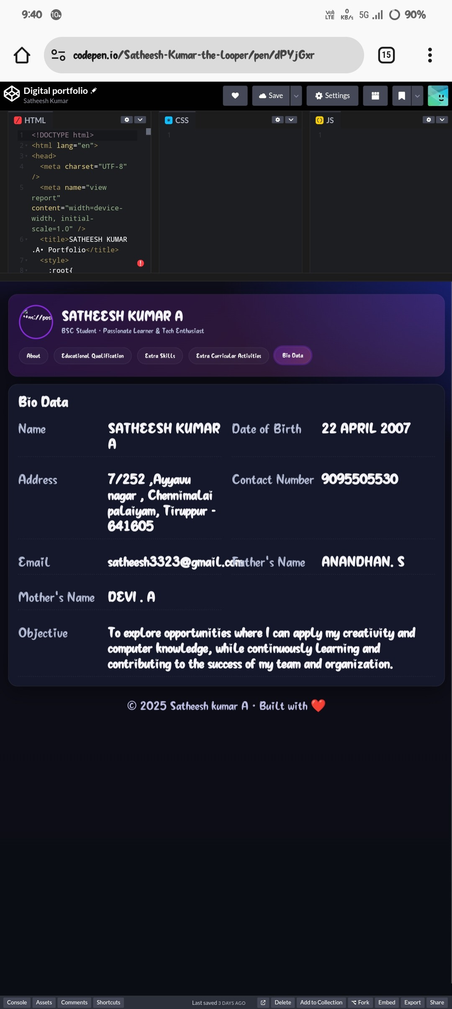

Slide 11


FEATURES AND FUNCTIONALITY
FUNCTIONALITY :
UI DESIGN :
Tabswitching betweensections Dynamic footer year Responsive grid adjustments Circular profile photo avatar
whitetheme with purple and hot pink accents
Card-based layout & tab navigation
Responsive design (desktop, tablet, mobile)
Hover effects, rounded corners & shadows
CONTENT ORGANISATION :
ACCESSIBILITY :
Hero Section → Photo, name, tagline
About → Intro + programming skill pills
Education → Academic details
Skills → Programming, soft skills, languages
ARIA labels for screen readers Semantic HTML for better SEO & accessibility
Activities → Hobbies (playing, Drawing) Bio Data → Personal details in grid
Footer → Auto-updated copyright year
Page | 09

Slide 12


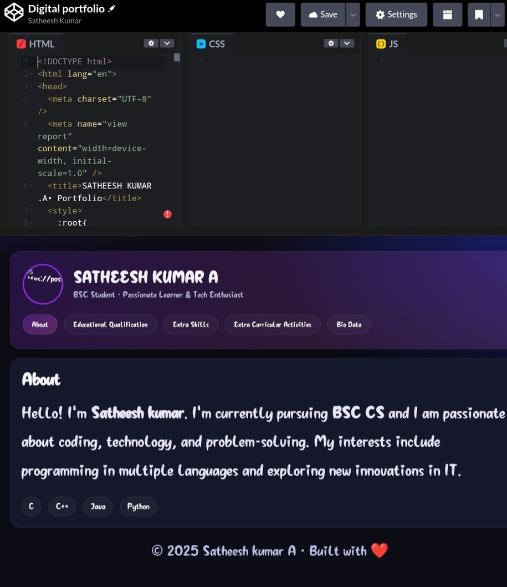
RESULTS AND SCREENSHOTS
DEVLOPED PROFESSIONAL DIGITAL PORTFOLIO FORSABARI PRIYA :
Displayspersonalinfo,education,skills,activities, bio-data
Tabbed navigation forsmooth sectionswitching
Responsive design (desktop & mobile)
Dynamic footer year auto-updated
SCREENSHOT
( KEY SECTION) :
Home / Hero → Photo, name, tagline, tabs About → Introduction + programming skills
Education → Bsccs details
Skills → Technical & soft skills
Activities → Hobbies: playing, Drawing
Bio Data → Personal info + career objective
Footer → Auto-updated copyright year

Slide 13

CONCLUSION
Successfullydeveloped Satheesh kumar digital portfolio using HTML, CSS, JavaScript
Transforms a traditional resume into an interactive, responsive, user-friendly online portfolio
SHOWCASES :
Personal details & bio-data Education, technical skills, extracurricular activities Modern design (darktheme+purple and hot pink accents)
Dynamic features: tab switching & auto-updating footer
Emphasizes the importance of digital presence and allows future enhancements
(projects, achievements, downloadable resume)

Slide 14

GITHUB LINK
https://github.com/satheesh3323/Satheesh-Kumar-A-TNSTC-FWD-DP.git

Slide 15
THANK YOU

